Slide 1

CS-130: Legal Issues in Computing
Understanding Civil Law and the UK GDPR

Slide 2

Learning Goals
What are the differences between civil and criminal law?
Why do we need Data Protection
What is the core idea of the UKGDPR?

Slide 3
English Law
English Law is a huge, old, unique system of law with key elements being:
Judicial precedent – judges are bound to follow decisions of superior courts
Civil and Criminal Classification – crimes against society and disputes between parties are separate
English Law has multiple sources
Statutes: Made by Parliament
Common law: Precedent as established by judges
EU Law: Made by the EU
English law isn’t just English? USA, Canada, Australia and NZ all have similar underpinnings

Slide 4
Core Concepts in English Law
The Rule of Law: every person must obey the law no mater who they are and has essential components such as Equality, Fairness, Retrospective, Fairness and Due Process
Right to Trial By Jury: Anyone accused of a crime has the right to be tried in front of their peers…. but you don’t always have to be
Civil Law does not always require a jury because you are not being found guilty of a crime but are being found liable for some damages
So why is this?

Slide 5
What is the difference between criminal and civil law?

Slide 6
Criminal vs Civil Law
Criminal Law
Aim: is to regulate the punishment for crimes against society and the individual
Commencement: the Police and Crown Prosecution Service investigations
Burden of proof: the State to prove beyond reasonable doubt
Venue: Magistrates or Crown Court
Civil Law
Aim: to regulate relationships between individuals and other individuals and organisations
Commencement: Individuals/organisations suing other individuals/organisations
Burden of Proof: The Individual proves on the balance of probability
Venue: County Court or High Court

Slide 7
Criminal vs Civil Law
Criminal Law
Outcome: Conviction or acquittal
Remedy: Sentence to a punishment imposed by the state
Civil Law
Outcome: Defendants or is not liable to claimant
Remedy: Damages or other remedy such as injunction
Crown Prosecution Service – the people who prosecute crimes brought to them by the police
Acquittal – different to being found innocent, you are not guilty
Liability – being found responsible for a harm caused

Slide 8
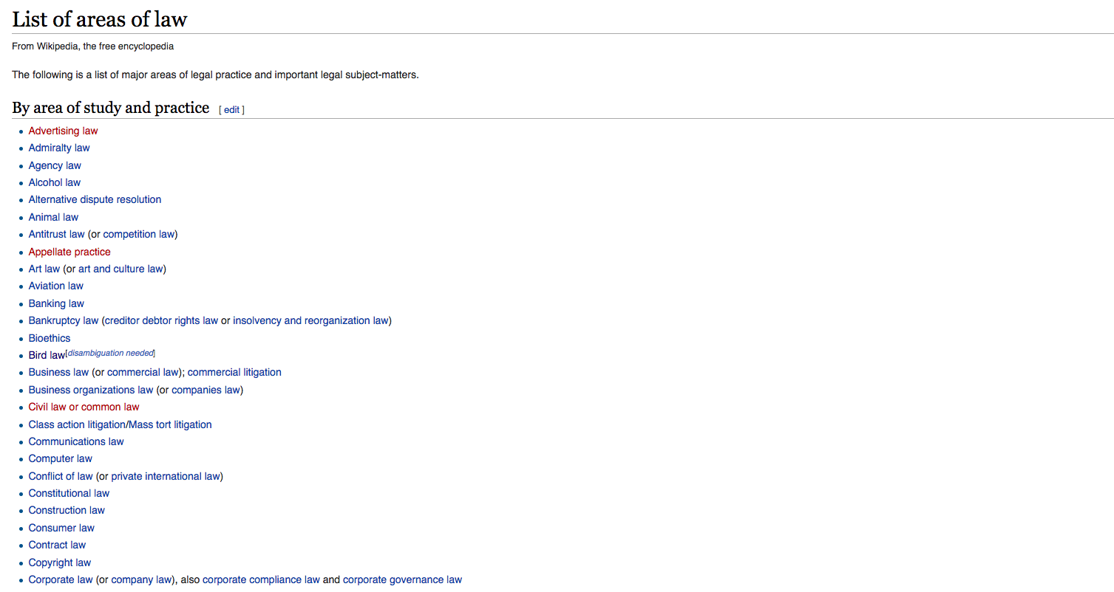

Slide 9
Understanding Data Security
By now we know that there are various possible attacks on computer systems and that there are ways to defend against those attacks
Now we look into the legal obligations that come with this issue and problems from the international nature of modern computing
A key point to understand and accept as you look at this – you WILL handle other peoples data in computer science!
An important reminder – ignorance of the law is not an excuse for breaking the law!

Slide 10
A Case Study to think about
2003 – A customer ordering lingerie online notices that “customer id” appears in her URL and random ID’s give corresponding users names and shopping history
The company’s response when contacted:“ Well, there's no credit card numbers being displayed, so what's the big deal?”
Customer tells reporter “'I don't think Tammy so-and-so from Ridgefield, Connecticut, would want me to know that she ordered this or that”
The company's privacy policy assures discretion…

Slide 11
Were data protection laws violated?
In the US – ?
??
??
In the EU and UK – ?
??
??

Slide 12
Were data protection laws violated?
In the US – Sort of….
US philosophy is market driven
Each data holder must publish a policy, and can be sued if this is violated but this is a contract violation and nuanced
In the EU and UK – Yes
If customers are identifiable from visible details, though it’s not clear otherwise
EUDPD gives strict guidance, ratified in law by member states like The GDPR

Slide 13
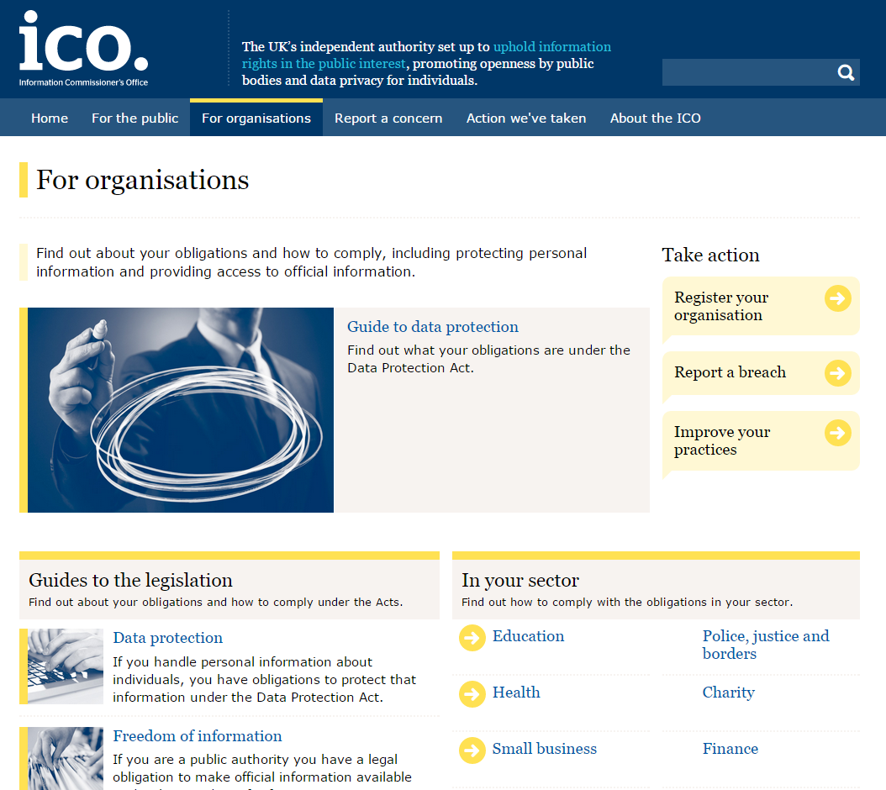

Slide 14
The General Data Protection Regulation
The GDPR describes three types of data:
Personal data – name, address, NI number, passport number, any personally identifiable information must be protected
Sensitive data – racial origins, sexual orientation, religion, politics, sex life, criminal activity, health problems that require additional protection, things you might be discriminated against because of
Credit information – in a league of it’s own!
ALL data in “accessible format” is covered, not just data on a computer

Slide 15
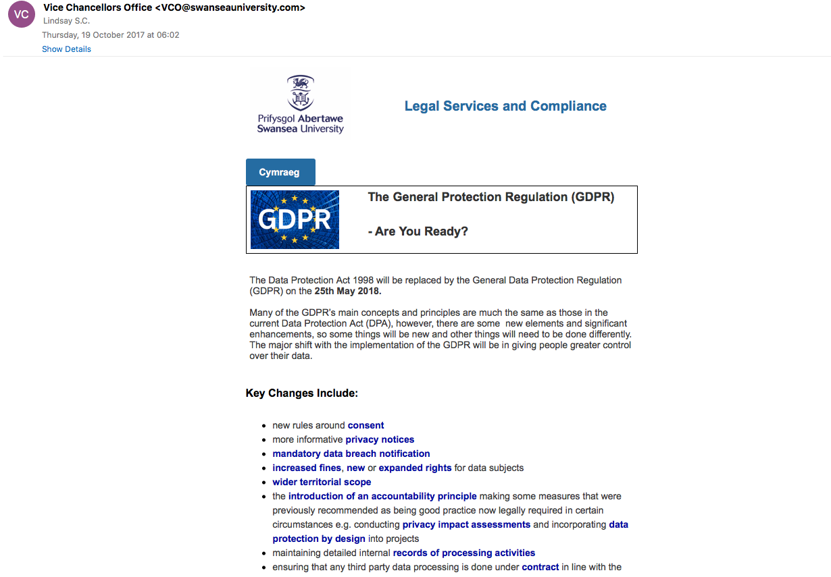

Slide 16
UK General Data Protection Regulation
Outlines 5 principles to follow when gathering personal data and covers any data about a living and identifiable individual
To hold or process data an individual must notify the Information Commissioners Office (ICO) of the companies status as a Data Controller
While not expected to oversee each worker in them, a Data Controller must ensure sensible secure principles are applied, and that suitable training is given
Failure to comply with the Data Protection Act can result in civil claims for damages or even criminal prosecution by the ICO and CPS

Slide 17
GDPR
Data Controller - determines the purposes for which, duration of and the
manner in which personal data is used
Ultimately holds the responsibility for the data and meeting the DPA
Data Processor- often a sub contracted company that handles data without making key decisions about the data
Might control how data is stored
How data is transferred
Specifics of the security of the data
However, just because one company contracts another it doesn’t automatically make them a processor

Slide 18
What makes someone an “Identifiable Individual”?

Slide 19
(Mis-)Use to protect foolish behaviour
2003 – a utility company cut power to elderly couple
One of the couple died, cold contributed to death
Local Social Services criticised the company for not informing them
Utility company used DPA as defence
The ICO publicly dismissed this defence saying that the DPA does not override protection of life

Slide 20
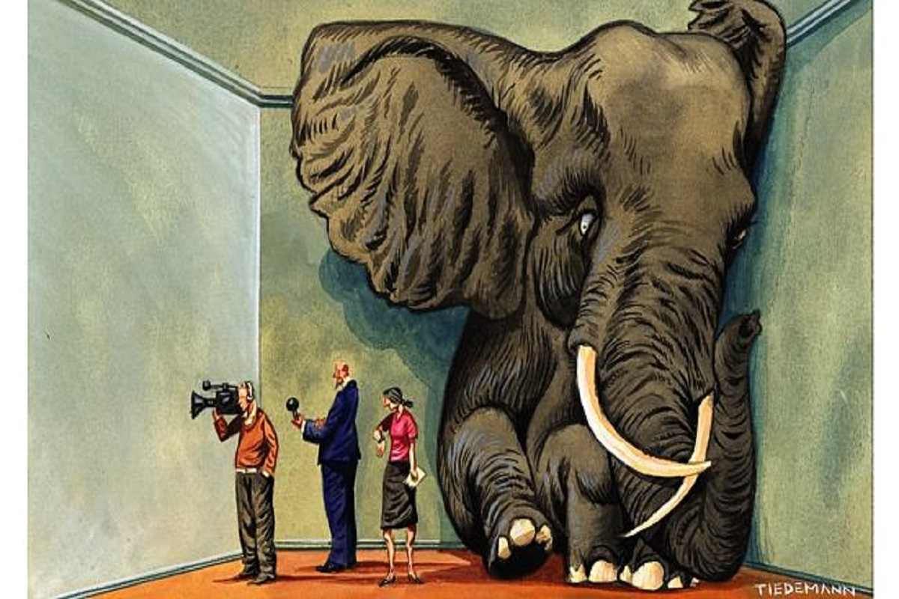

Slide 21
Learning Goals
What are the differences between civil and criminal law
Why do we need Data Protection
What is the core idea of the UKGDPR?

Slide 22
Learning Goals
What are the differences between civil and criminal law
Civil law is about liability and balance of probability, criminal law is about guilt and being beyond a reasonable doubt
Why do we need Data Protection
Companies behaviour without it can be unethical and threaten our privacy or worse!
What is the core idea of the UKGDPR?
A set or rights and principles to protect us from intrusive, dangerous or unfair use of our personal data by making it illegal

